Slide 1

CHAPTER 19
Introduction to
Social Media
Notes:
1.#

Slide 2
Objectives
After studying this chapter, the student should be able to:
Define the friendship relationship in Facebook.
Define the two-way relationship between friends in Facebook.
Understand the communication channels in Facebook.
Know how to become a member and how to terminate membership in Facebook.
Know how to log in and log out of Facebook.
Know how to find friends in Facebook.
Know how to communicate with followers in Twitter.
Define the following relationship in Twitter.
Define the one-way relationship between members and followers in Twitter.
Understand the communication channels in Twitter.
Know how to become a member and how to terminate membership in Twitter.
Know how to log in and log out of Twitter.
Know how to follow other members in Twitter.
Know how to communicate with followers in Twitter.

Slide 3
19-1 INTRODUCTION
In the last century, when computer science started as a discipline, we could never have imagined that it would become a part of our daily life in such a short period of time. One of the areas in which computer science has helped all citizens is with the advent of social media. Today most people around the world are, to a greater or lesser extent, involved with one or more types of social media, which can be considered a computer science application. Social media is in fact the result of using several computer science disciplines including operating systems, computer programming, computer networks, and databases.

Slide 4
Social media platforms are websites on a large scale, designed to let people exchange their ideas, opinions and experiences. Some are designed primary for exchanging messages or pictures; some are designed to let job seekers find employers, and employers find employees.
A discussion of all types of social media would take a book by itself. In this chapter, therefore, we look at only two of them: Facebook and Twitter. We have chosen these two as examples, as the concepts behind Facebook and Twitter are duplicated, more or less, in several other sites.

Slide 5

19-2 FACEBOOK
Facebook is a social network that allows families and friends around the world to keep in touch with each other and share thoughts, pictures, comments, and so on.
Facebook allows members to share thoughts,
pictures and comments.
19.2.1 General Idea
Before explaining how to use Facebook, let us consider the general ideas behind it.

Slide 6
Friendship
In Facebook, sharing is done only between friends. Friendship is a one-to-one reciprocal relationship. If John is a friend of Lucie, Lucie is also a friend of John. However, the relationship does not propagate; if John is a friend of Lucie and Lucie is a friend of Ann, it does not necessarily means that John is a friend of Ann. To be so, John or Ann needs to request friendship from the other.
In Facebook, a friend of a friend is not necessarily a friend.

Slide 7

Although there are billions of members in Facebook, we will assume for the purposes of this discussion that it has only eight members (Ml to M8), as shown in Figure 19.1.
Figure 19.1 A Facebook site with only eight members

Slide 8
Now assume that the following requests for friendship are made and are all accepted by the other members:
Ml requests friendship from M2.
M2 requests friendship from M5.
M3 requests friendship from M2.
M4 requests friendship from M7.
M6 requests friendship from M3.
M7 requests friendship from M6.
M8 requests friendship from M2.

Slide 9
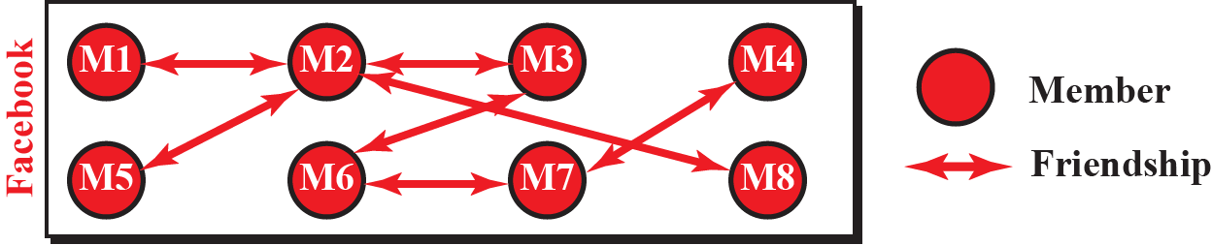
Figure 19.2 shows the friendship relationships between the eight members
Figure 19.2 Relationship between members after friendship requests
Note that Facebook holds the information about each member, but adds a link between two friends after the friendship has been requested and approved.

Slide 10
Communication
Although friendship between members is a two-way relationship, we can think of communication as a one-way (one-to-many) relationship: one member posts something, and all their friends can see it, as shown in Figure 19.3:

Slide 11
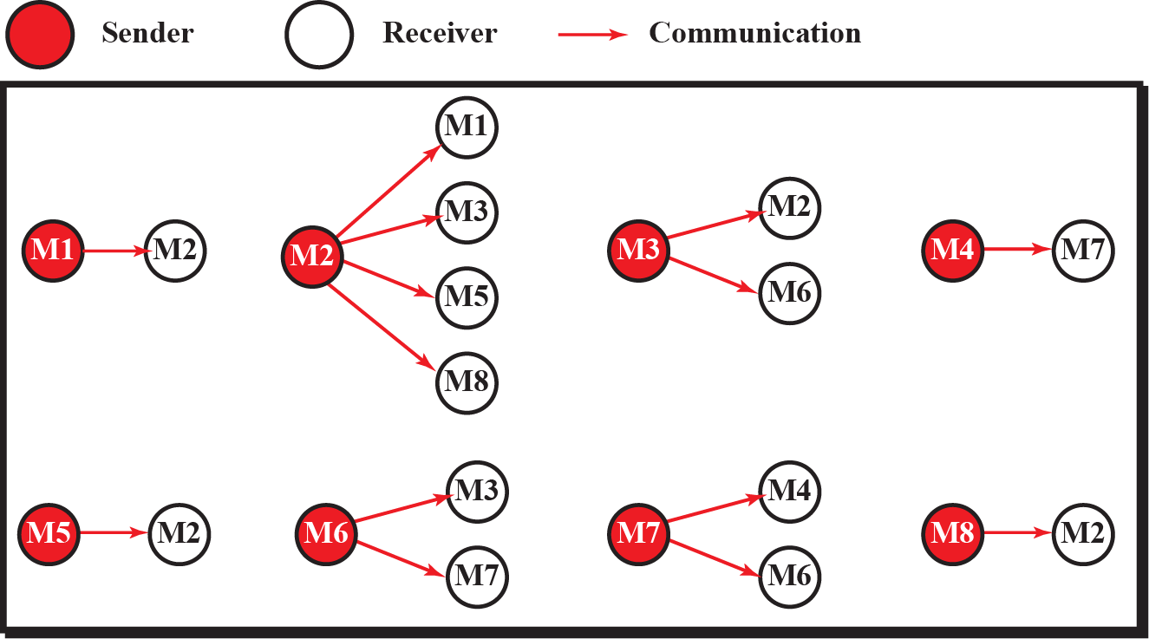
Figure 19.3 One-to-many communication in Facebook

Slide 12
What is posted by Ml can be seen by M2.
What is posted by M2 can be seen by Ml, M3, M5, and M8.
What is posted by M3 can be seen by M2 and M6.
What is posted by M4 can be seen by M7.
What is posted by M5 can be seen M2.
What is posted by M6 can be seen by M3 and M7.
What is posted by M7 can be seen by M4 and M6.
What is posted by M8 can be seen by M2.

Slide 13
19.2.1 Web pages
Facebook uses several pages, but the two used most often are the home page and the general page. Let us show these two pages before explaining how to use them.
Home page
The home page is used only for sign-up (enrolling) and log-in (accessing) Facebook. The general form is shown in Figure 19.4.

Slide 14
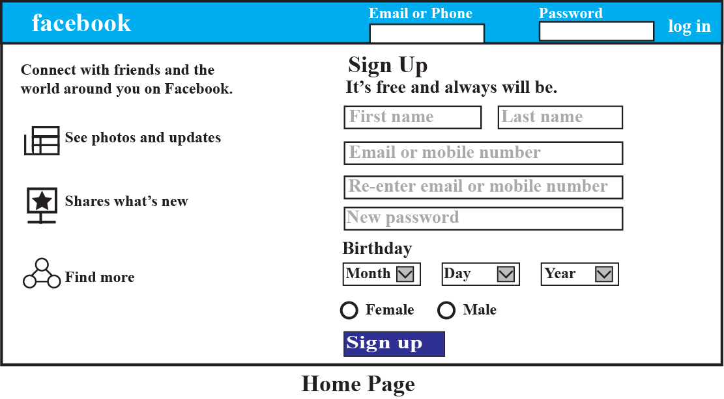
Home page
The home page is used only for sign-up (enrolling) and log-in (accessing) Facebook. The general form is shown in Figure 19.4.
Figure 19.4 Facebook home page

Slide 15
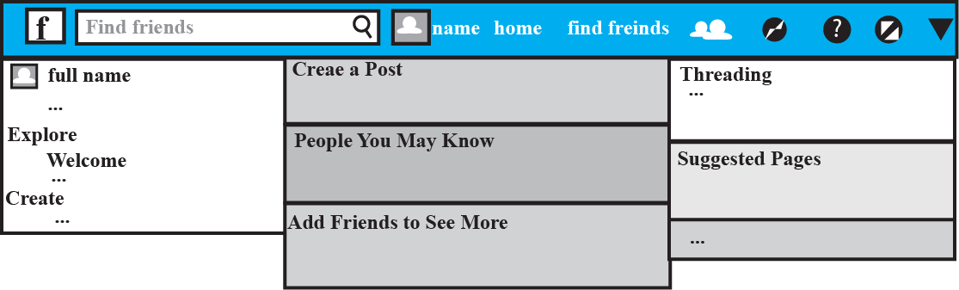
User page
The user page is the main page you will use on Facebook. The page is fairly complex, but the general format is shown in Figure 19.4. Note that your page always has a toolbar as the first row. It has three columns, but the two columns on the left can be scrolled to show more options.
Figure 19.4 Facebook user page

Slide 16
19.2.3 Membership
You need to be a member of Facebook to use it. To become a member, you need to sign up. To terminate your membership, you need to sign out or deactivate your account.

Slide 17
Sign up
To become a member of Facebook (which is free), you need to go to the Facebook home page (www.facebook.com) as shown in Figure 19.4. You can then use the following steps to sign up.
Ignore the log-in section (first row) and go to the sign-up section.
Enter your first and last name in the corresponding boxes.
Enter your email or mobile number in the corresponding box.
Re-enter your email or mobile number in the corresponding box.
Select your data of birth (Month, Day, Year).
Check your gender button.
Click on the sign-up button.

Slide 18
Sign out (deactivation)
To permanently deactivate your account in Facebook, go to your home page (Figure 19.5) and do the following:
Click the down arrow on the far right of the tool bar.
In the submenu that appears, click on Settings.
Click on Security.
Choose Deactivate your account and follow the steps to confirm it.

Slide 19
19.2.4 Accessing services of Facebook
Even if you have signed up as a member, whenever you want to use Facebook, you need to log in. When you do not want to use it for a while, you can log out.

Slide 20
Log in
To log in into your account, go to the Facebook home page at www.facebook.com (Figure 19.5). In the first row, type your email or mobile number, type your password, and click on the log-in button. You will see your page, which means you can now use Facebook.
Log out
Whenever you are not using your Facebook page for a while, you can log out. On the toolbar of your page (Figure 19.5) click on the down arrow to see the menu. Then click on the log-out button.

Slide 21
19.2.5 Friends
As described above, the whole idea of using Facebook is to keep in touch with friends. If you post something on the Facebook site, you need to have friends to see it. If you want to see what another member posts, you have to be one of their friends. In other words, you need to find friends and let other members find you as a friend before you can start to communicate through Facebook.

Slide 22
Finding friends
There are several ways of finding friends in Facebook.
Accept Facebook recommendation
You can accept a Facebook recommendation, based on the information you provided during sign-up. To accept a recommendation, go to the toolbar of your page (Figure 19.5) and click on the find friend button, which displays a list of people whom you may know.
Follow email contacts
You can follow people who regularly contact you by email. On your home page toolbar (Figure 19.5) click on the friend icon (two faces next to find friend button). Facebook displays a page with different email icons. Choose the appropriate one and type your email and password to see a list of individuals who communicate with you by email. If you want someone on this list to be your Facebook friend, click on the add friend button.

Slide 23
Look for old friends
At the left side of your home page toolbar (Figure 19.5) type the member name and click on the search icon. Facebook shows the list of members with that name. If you find someone you know, click on the name to see their profile page. If you want that person to be your Facebook friend, click on the add friend button.

Slide 24
Accept friendship from other members
Other members may want to add you as their friends. In this case, you may accept or decline friendship when you receive the request. On the toolbar, click on the friend request button. You will see the profile for every member who has sent you a request to be your friend. You can click the confirm or decline button in front of the member name to accept or reject the invitation.
Unfriend a friend
You can remove any member from your friends list at any time. To do so, click on your profile picture on your home page toolbar (Figure 19.5). Click the friends button under your name to see the list of your friends. Scroll down until you see the name of a member that you want to unfriend. Then click on the unfriend button.

Slide 25
19.2.6 Exchanging information
The whole purpose of Facebook is to allow friends to exchange news (texts, photos, videos, etc). To receive your friends’ posts, go to your news feed where they will appear. To send news to your friends, you need to update your status. We will briefly show these two activities.
Reading news
To see what news your friends have posted, go the toolbar (Figure 19.4) and click on the home button. You will see all the new posts made by your friends at the button section. Each post includes the name of your friend, the date it was posted, and the contents. They may also contain links to web pages. Posted photos will also appear there, but you may want to make them larger by clicking on them. If there are videos in the posts, a thumbnail appears in the body of the news feed with the play arrow; click it to play the video..

Slide 26
Commenting on posted updates
At the top of each item of posted news (called an update), there is a like button that you can click on to show that you like the post.
Sharing posted updates
Click the share button underneath the original post to see a new window. Enter any comments you want to make about the post in the new window and then click the share button in the new window. In this way, you can post what you have received to your own friends.

Slide 27
Posting news
Facebook allows you to post news (called updates) for your friends. This can be a long message (up to 60,000 characters), a link to a web page, a photo, or a video.
Posting news
To post news, go to the toolbar (Figure 19.5) and click on the home button to see the posting window. The update status will be selected by default. Click on the what’s on your mind button and type your news. Then click the post button to post the news for your friends.
Posting photos or videos
In the posting window, click on the add photos/video button and then select the right-hand button to post your photos or videos.

Slide 28
Tagging
If you want to mention a friend in your post, you can tag that friend. To do so, you need to click on the tag button (picture of a head) and then select the name of the friend from the list.
Limiting who can see your post
Generally, when you post something on Facebook, all Facebook members can see it. You can restrict this just to your friends or even just to yourself. In the status update window, click the button public to let anyone see the post, click the friends button so that only your friends see the post, or click the only me button so that no one except you sees the post.

Slide 29
19-2 TWITTER
Twitter is a social network that allows members to post a short message, called a tweet, of a maximum 140 characters, for their followers to see.
Twitter allows members to post a tweet for their followers.
19.3.1 General Idea
Before showing how to use Twitter, let us discuss the general idea behind this social media site.

Slide 30
Member–followers relationship
In Twitter, the relationship is between members and their followers; a one-to-many relationship. A group of Twitter members follow the member they like; the followed member may not even know who their followers are. This is similar to the relationship between a celebrity and her followers: the followers are interested in what the celebrity does, but the celebrity will probably not know who these followers are.

Slide 31
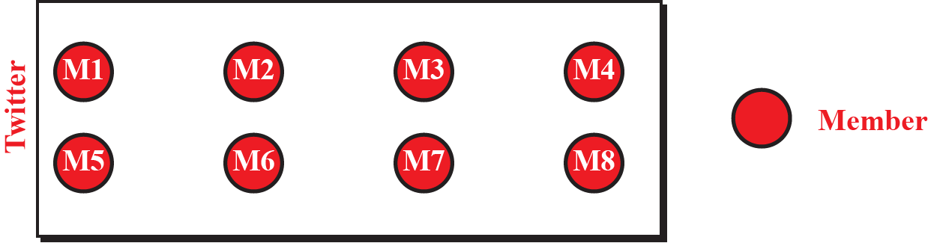
Let us assume that we have eight members registered on the Twitter site as shown in Figure 19.6. Now assume some members decide to follow other members as shown below:
Figure 19.6 Twitter with only eight members registered

Slide 32
M1 follows M2 and M5.
M2 follows M3.
M3 follows M4 and M5.
M4 follows M3 and M8.
M5 follows M2 and M6.
M6 follows M8.
M7 follows M3.
M8 follows M7.

Slide 33
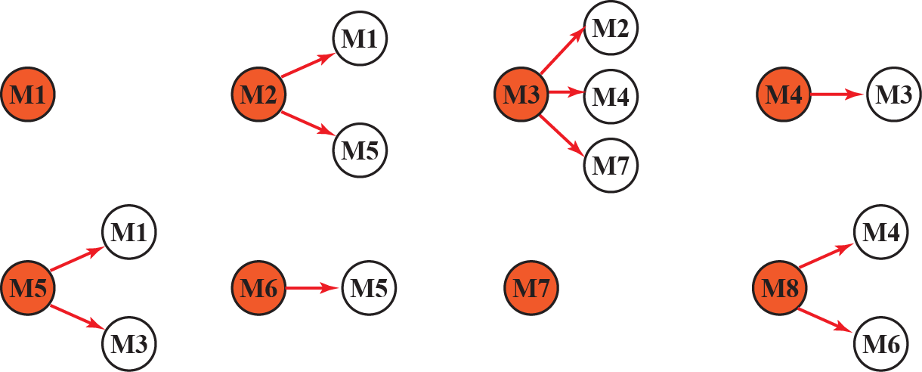
Communication
In Twitter, it is also easier to think of communication as a one-to-many relationship. A member posts a tweet for here followers. Figure 19.8 shows the situation for the previous scenario.
Figure 19.8 One to many communication in Twitter

Slide 34
M1 has no followers. This means that what is posted by M1 can be seen by no one.
M2 has M1 and M5 as followers. This means that what is posted by M2 can be seen by M1 and M5.
M3 has M4 and M7 as followers. This means that what is posted by M3 can be seen by M4 and M7.
M4 has M3 as follower. This means that what is posted by M4 can be seen by M3.
M5 has M3 and M1 as followers. This means that what is posted by M5 can be seen by M3 and M1.
M6 has only M5 has follower. This means that what is posted by M6 can be seen only be M5.
M7 has no followers. This means that what is posted by M6 can be seen by no one.
M8 has M6 and M4 as follower. This means what is posted by M8 can be seen by M6 and M4.

Slide 35
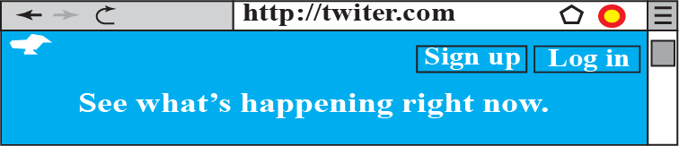
19.3.2 Pages
The Twitter website has several pages, but the two used primarily are the web page and the home page. Other pages can be reached from one of these two pages. Let us describe these two pages before explaining how to use them.
Web page
The web page is used for joining Twitter for the first time or when you want to log into your account (Figure 19.9).
Figure 19.9 Twitter web page

Slide 36
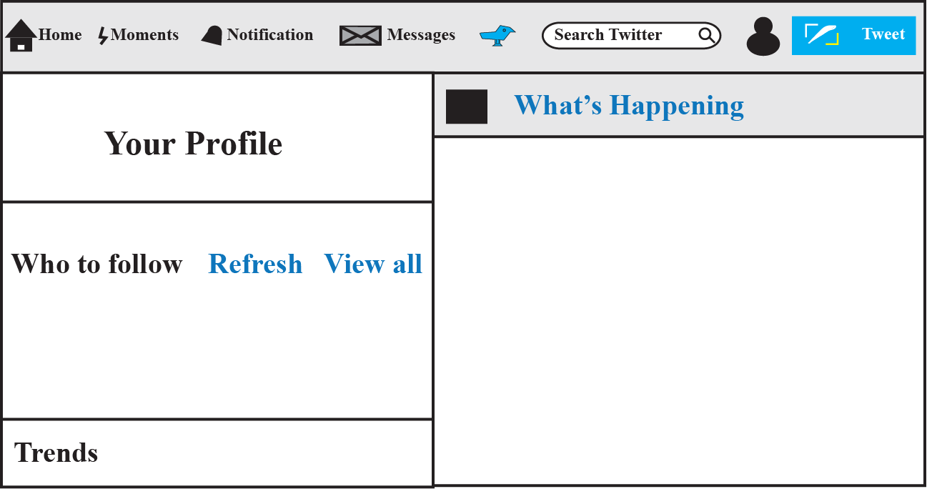
Home page
The home page is used when you have already have an account with Twitter and you want to use it. The general format of this page is shown in Figure 19.10.
Figure 19.10 Twitter home page

Slide 37
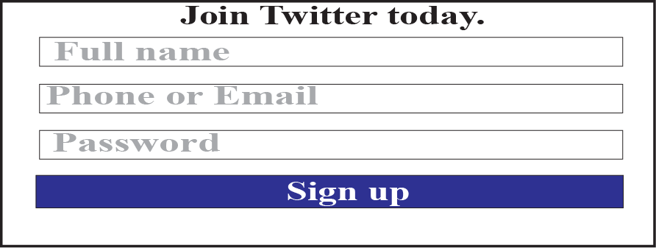
Sign up
To become a member of Twitter, go to www.twitter.com to find the Twitter web page, as shown in Figure 19.9. Then click on the sign-up button to see the sign-up window as shown in Figure 19.11.
Figure 19.11 Twitter sign-up window

Slide 38
Sign out (deactivation)
To permanently deactivate your account in Twitter, go to the Twitter home page (Figure 19.10) and do the following:
Click the profile and settings icons.
When the new window opens, click on the settings and privacy buttons.
When the new window opens, click on the deactivate my account button.

Slide 39
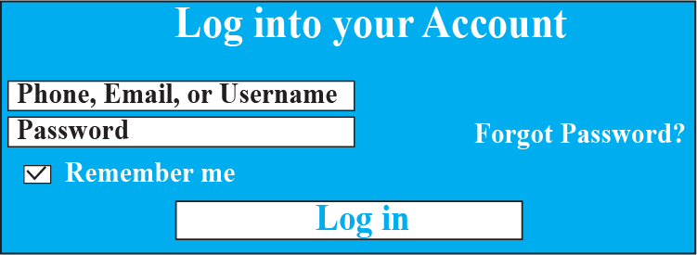
19.3.4 Accessing services of Twitter
Even if you are a member, whenever you want to use Twitter, you need to log in. When you do not want to use it for a while, you can log out.
Log in
When you are a member, you can log in to your account from any computer or smartphone. On the Twitter web page (Figure 19.9), click on the log-in button to see the log-in window as shown in Figure 19.12.
Figure 19.12 Twitter log-in window

Slide 40
Log out
To log out of your account in Twitter, go to the Twitter home page (Figure 19.10) and do the following:
Click the profile and settings icons.
When the new window opens, click on the log-out button.

Slide 41
19.3.5 Following and being followed
The whole idea of Twitter is to enable members and their followers to communicate. Members can receive tweets if they follow other members. If members have followers, they can send tweets which will be received by their followers.
You need to follow other members
If you want to receive tweets from certain members, you need to let Twitter know that you want to follow them. There is no need to get permission from the member you want to follow (unless they explicitly ask Twitter to block you as one of their followers). If you enter the names of the members you want to follow, Twitter creates a list of them in your profile and every time any of these members sends a tweet, you will get a copy. The question is: how do you tell Twitter who you want to follow? There are several ways to do this.

Slide 42
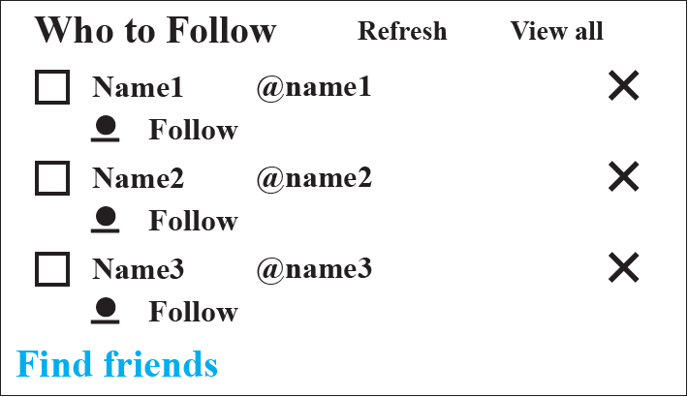
Accept Twitter recommendation
You can accept Twitter’s recommendation (based on your past activity and interests). To do this, go to the bottom left section of the Twitter home page, the who to follow window, as shown in Figure 19.13 and click the view-all button to see Twitter’s recommendations. To learn more about any of these members, click on the @name. To follow a member, click the follow button.
Figure 19.13 Who to follow page

Slide 43
Follow email contacts
You can follow people who regularly contact you by email. On the who to follow page (Figure 19.13) click on the find friends button (at the bottom of the right-hand column). A list of email providers appears on the next window, from which you can choose those friends who communicate with you via those email providers.
Search for specific people or organizations
On the who to follow section (Figure 19.13) click the view all button. When the new window opens, enter either the actual name or the Twitter name of the person or organization you are looking for. Now click the search button. If an individual or organization with that name is a Twitter member, you can choose to follow them.
Stop following a member
You may for some reason want to stop receiving tweets from a member. To do so, you must unfollow them. Go to the Twitter home page, click on the following link. Move the mouse over the follow button for that member and change it to unfollow button.

Slide 44
Other members following you
If you want your tweets to be read, you need to have followers to receive them. However, you cannot choose your followers; they have to find you and decide to follow you. They do not need to get your approval to follow you, but if you wish to, you can inform Twitter that you want to block a specific follower.

Slide 45
19.3.6 Sending tweets
You can compose and send a tweet to all your followers. The dilemma is that you do not know your followers. They have selected you; you have not selected them. The good news is that Twitter knows all of your followers; it has a list. To send a tweet to your follower, post it on the Twitter site and let the site send it to all of your followers..

Slide 46
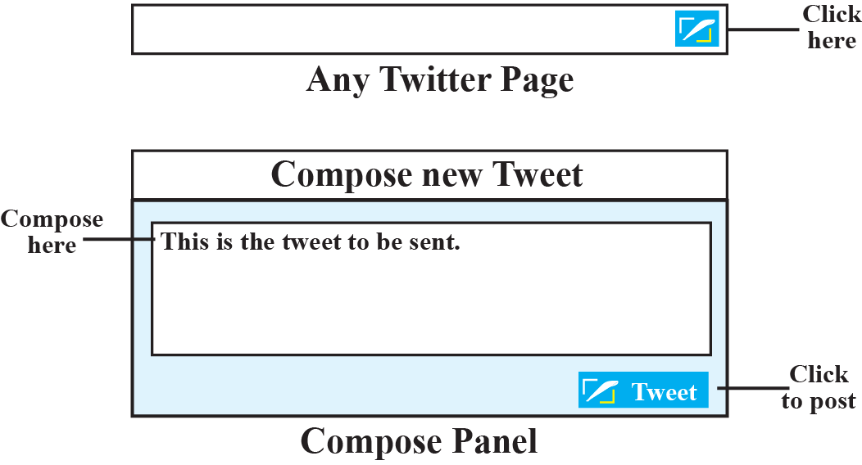
Compose a new tweet
The first thing you need to know is how to compose a new tweet. This can be done as follows (see Figure 19.14).
Figure 19.14 Composing a new tweet

Slide 47
Click the tweet button on any Twitter web page to see the compose new tweet panel.
In the compose new tweet panel, type your message.
Click the tweet button at the bottom of the page to post your tweet.
Twitter takes your tweet and adds your profile, including your name, at the top of the tweet.
Twitter then sends a copy to all your followers.

Slide 48
Referring to other people’s tweets
In any tweets you send, you can also refer to the tweets of other users. This can be done in two ways: by using ampersands and/or by using hashtags.
Using ampersands
When you are sending a tweet to your followers, if you want to refer to the tweets of another user, you can insert the name of that user preceded by an ampersand (@). Any of your followers can click on the name to see tweets posted by that user.
Using hashtags
Sometimes you want to refer to a set of tweets that contain a specific word or phrase originating from different senders. In this case you can use a hashtag (#) in front of the word. The word becomes a keyword and any click on the word displays all recent tweets that contain that word.

Slide 49
19.3.7 Receiving tweets
After you identify and designate those members that you want to follow, any tweet posted by any one of them comes to your Twitter home page (also called your Twitter feed). To get to your home page, click on the home icon at the top-left of the Twitter toolbar (Figure 19.10) which enlarges the what’s happening section. After reading any tweet, you can
click on the arrow to compose a tweet in response to the sender of the tweet.
click on the double arrow to retweet the received tweet to their own followers.
click on the star to show that you like the tweet.

